Slide 1
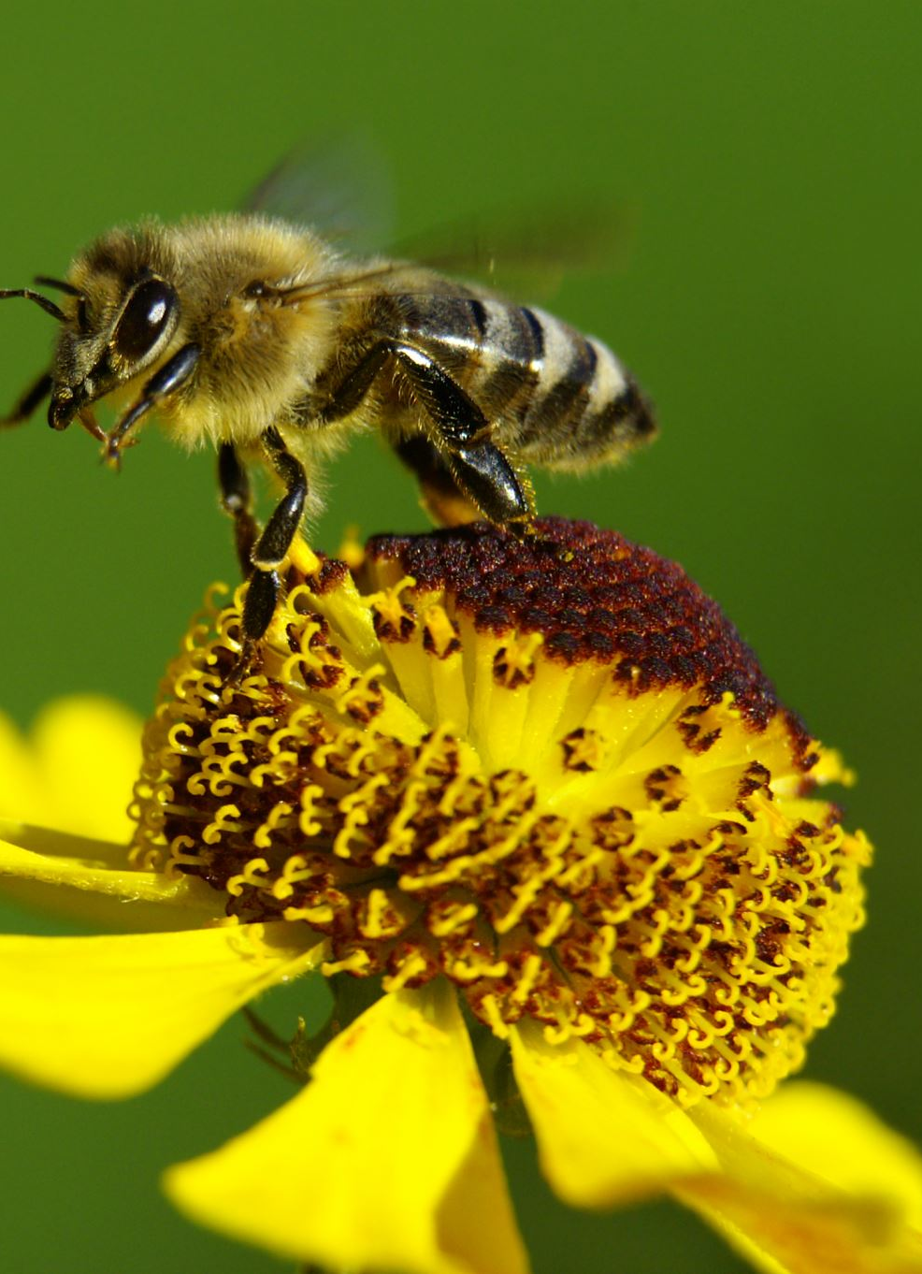
Pollinator abundance survey on WCU Campus
Native bee species populations are declining
(Kopec and Burd 2017)
About 1 in 4 native bee species are at risk of extinction
Leading causes
Agricultural intensification
Habitat destruction
Pesticide use
Climate change
Urbanization
How biodiverse is WCU campus for native plants and pollinators?
What management practices are beneficial to native plants and pollinators?
J. Ted Hillert

Slide 2
Methods Field Literature Review
Survey
X2 observations per observer
10-minute interval along one meter transect
Visit count = pollinator flower visits
38 observations of 1136 flower visits of nine species types
Statistics
Shannon Diversity Index
Reviewed plant-pollination interaction in Solidago spp.
Pollinators negatively affected Moroń et al. 2009
Linear and non-linear effects Moroń et al. 2019
Invader-pollinator paradox Moroń et al. 2021
Reviewed conservation protocol
Managing for pollinator services vs pollinator diversity Senapathi et al. 2015
Conservation planning Mačić et al. 2018
Notes:
Surveys monitored pollinator visits to flowers along a four meter transect for two 10-minute intervals per observer
Visit counts are based on number of flowers an individual pollinator visits
A total of 38 observations of 1136 pollination visits by Honeybees, Flies, Wasps, Bumble and Carpenter bees, Small bees, Small butterflies, Large butterflies, beetles, and ants

Slide 3
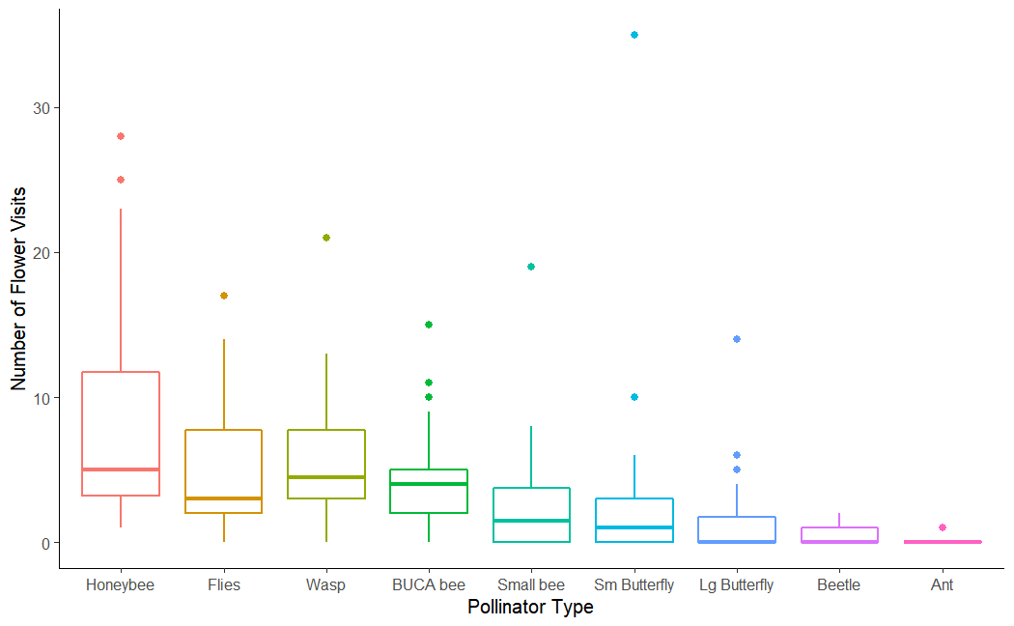
Results
Figure 1. Pollinator abundance and diversity curve for a strip dominated by Solidago spp. on WCU campus. Boxes are color coordinated to pollinator type with the thicker bar depicting the mean number of visits. Dots indicate possible outlying data points. Shannon Diversity Index = 1.89, species richness = 9, and Species evenness = 0.845. Figure generated from 38 observation intervals of 1136 total pollinator flower visits.

Slide 4
Management Implications & Future Research
Pollinator diversity is very low
Recent disturbance nearby
Plant native pollinator garden next to Apodaca
Study plant-pollinator associations
Mow 2x per year
Limit Cover
Notes:
Pollinator diversity is very low, with this patch favoring honeybees, large-bodied bees, and generalist flies
Recent disturbance nearby is likely to confound this lack in diversity
Installation of a pollinator garden on campus would increase plant and pollinator diversity and abundance on campus
Plant native species to attract a wide array of pollinators
Study plant composition and pollinator diversity changes over time
Develop a biyearly mowing protocol to maintain early successional meadow habitat. Once before the spring bloom in May and again in August after the flowering period
Limit cover to <30% for butterflies and ~50% for bees to promote their biodiversity

Slide 5
References
Kopec, Kelsey, and Lori Ann Burd. 2017. “Pollinators in Peril: A Systematic Status Review of North American and Hawaiian Native Bees,” Endangered Species, , February, 15.
Mačić, V., P. G. Albano, V. Almpanidou, J. Claudet, X. Corrales, F. Essl, A. Evagelopoulos, I. Giovos, C. Jimenez, S. Kark, O. Marković, A. D. Mazaris, G. Á. Ólafsdóttir, M. Panayotova, S. Petović, W. Rabitsch, M. Ramdani, G. Rilov, E. Tricarico, T. Vega Fernández, M. Sini, V. Trygonis, and S. Katsanevakis. 2018. Biological invasions in conservation planning: A global systematic review. Frontiers in Marine Science 5.
Moroń, D., M. Lenda, P. Skórka, H. Szentgyörgyi, J. Settele, and M. Woyciechowski. 2009. Wild pollinator communities are negatively affected by invasion of alien goldenrods in grassland landscapes. Biological Conservation 142:1322–1332.
Moroń, D., E. Marjańska, P. Skórka, M. Lenda, and M. Woyciechowski. 2021. Invader–pollinator paradox: Invasive goldenrods benefit from large size pollinators. Diversity and Distributions 27:632–641.
Moroń, D., P. Skórka, M. Lenda, J. Kajzer-Bonk, Ł. Mielczarek, E. Rożej-Pabijan, and M. Wantuch. 2019. Linear and non-linear effects of goldenrod invasions on native pollinator and plant populations. Biological Invasions 21:947–960.
Senapathi, D., J. C. Biesmeijer, T. D. Breeze, D. Kleijn, S. G. Potts, and L. G. Carvalheiro. 2015. Pollinator conservation—the difference between managing for pollination services and preserving pollinator diversity. Current Opinion in Insect Science 12:93–101.

